Slide 1
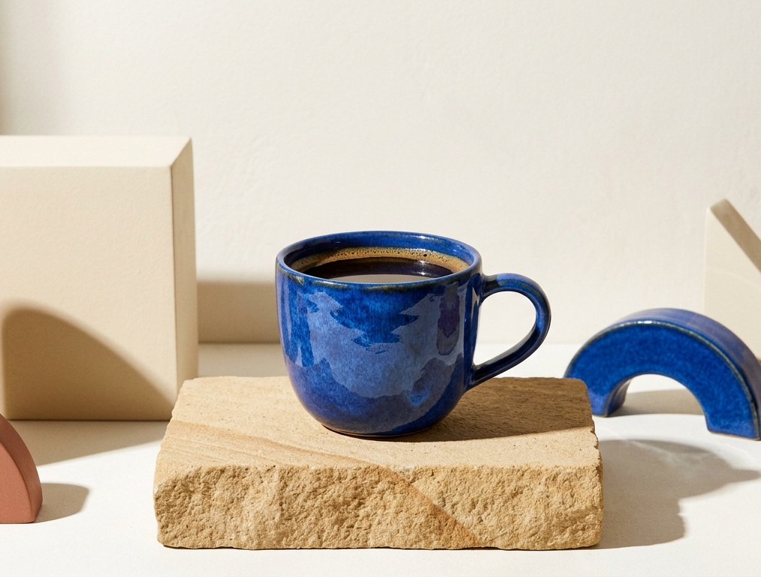
01 / 04
Studio
Sculptural and assured — hard sunlight turns the cup into a quiet design object.
AURORA / LAUNCH DIRECTIONS

Slide 2
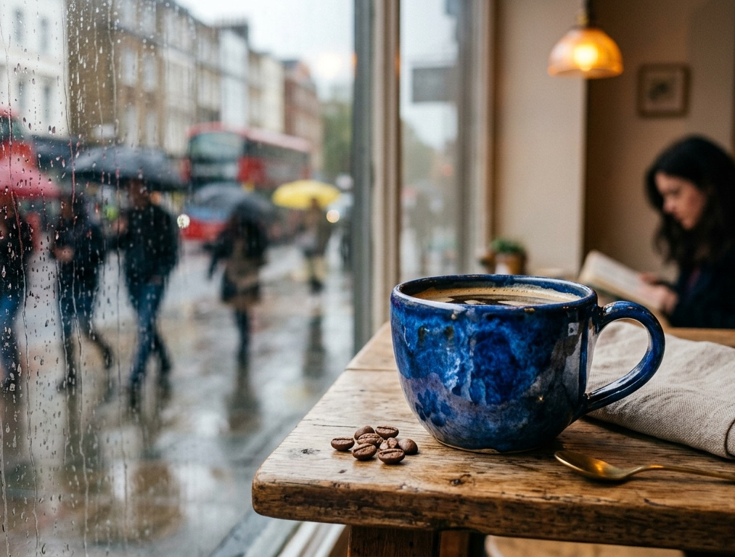
02 / 04
Rainy Café
Intimate and reflective — a warm pause held against the movement of a wet city.
AURORA / LAUNCH DIRECTIONS

Slide 3
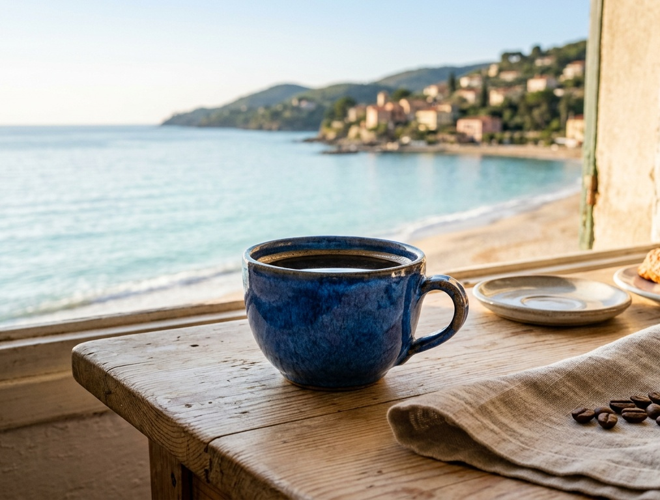
03 / 04
Coastal Breakfast
Open and restorative — slow coffee, sea air, and a little room to breathe.
AURORA / LAUNCH DIRECTIONS

Slide 4
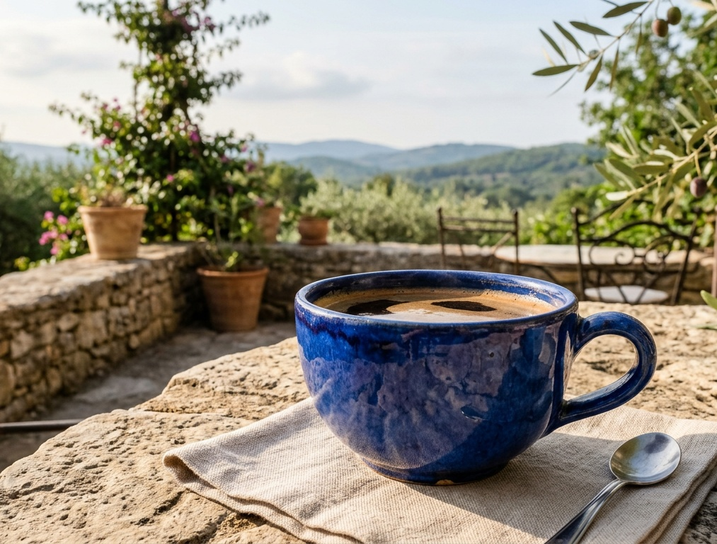
04 / 04
Terrace
Grounded and generous — an easy morning shaped by stone, greenery, and sun.
AURORA / LAUNCH DIRECTIONS

